Slide 1



A Mixed Methods Review of Cash Transfers
& Intimate Partner Violence in LMICs
*An Inside View*
AM Buller, A Peterman, M Ranganathan,
A Bleile, M Hidrobo & L Heise

Slide 2
Overall Aims
Review quantitative and qualitative evidence linking cash transfers (CT) and IPV, focusing on mechanisms underlying impacts
Build a program theory linking CT and IPV
Propose promising program design features and research gaps needed to further understand linkages/leverage potential of CTs

Slide 3
Study Design
Studies identified via: scoping, expert interviews, electronic databases, forward and backward citation
Inclusion criteria (14 quantitative & 8 qualitative):
  Published or grey literature completed before June 2017
  IPV: Physical, sexual, emotional, psychological, controlling behaviours between marital/cohabiting/dating partners
  CT: CCTs, UCTs, one-time lump transfers, bundled
  Quantitative if utilized an experimental or quasi-experimental design, including a rigorously defined counterfactual
  Qualitative if methodology sufficiently rigorous to be assessed as credible using the COREQ assessment tool
Notes:
No date cut offs, however qual ranged from 1999 – 2014 with most from 2011 onwards.
Consolidated criteria for reporting qualitative research (COREQ) checklist: a 32-item checklist for interviews and focus group discussions to assess the quality of the qualitative studies that have been included in this review (Tong et al, 2007). Two independent researchers scored the articles using three domains (1) research team and reflexivity, (ii) study design and methods, and (iii) data analysis and reporting, to give it a score of high, medium or low quality. We did not exclude any studies according to this assessment but report on the scores achieved by each study for reference.

Slide 4
Program characteristics (22 studies)
Program type
Geographic Region
Nearly all programs targeted women (*Kenya, South Africa)
10 quantitative & 3 qualitative Govt run
‘Plus’: In-kind transfer; Education, health sector linkages; trainings; behavior change communication
Multiple in Mexico, Ecuador, Peru, Uganda
Notes:
Published? Quant (7 published, 8 technical reports/working papers), Qual (2 published, 7 working papers/technical reports)
2/3 of studies were CCTs & CCT plus
A little over half were govt
2/3 in LAC
If not a lump sum transfer, most programs delivered benefits on a monthly basis, most were means targeted (poverty or demographic) and ranged from 6-50% of pre-program consumption exp.

Slide 5
High-level results: Impacts
Overall impacts on IPV
[22 studies]
Quantitative indicators
[56 total by IPV type]
11 of 14 studies
show reduction
Majority of studies (73%) showed decreases, impacts stronger for physical/sexual (44% of sex/phys versus 38% of others)
Overall 36% of quant indicators significant & negative; 2% significant & positive

Slide 6

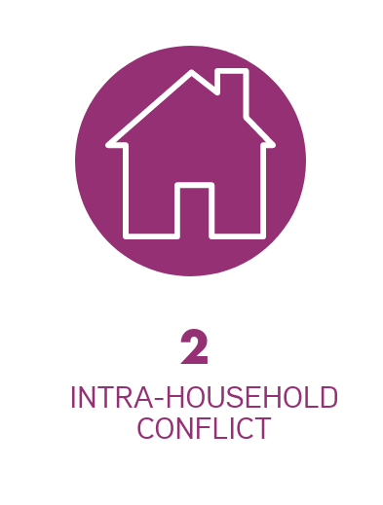
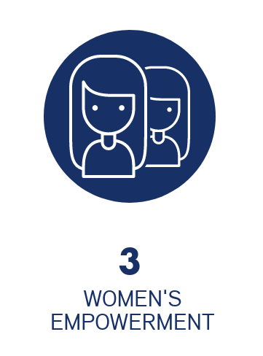
3 Main Pathways
Household level
impact
Marital dynamic
impact
Woman specific
impact

Slide 7

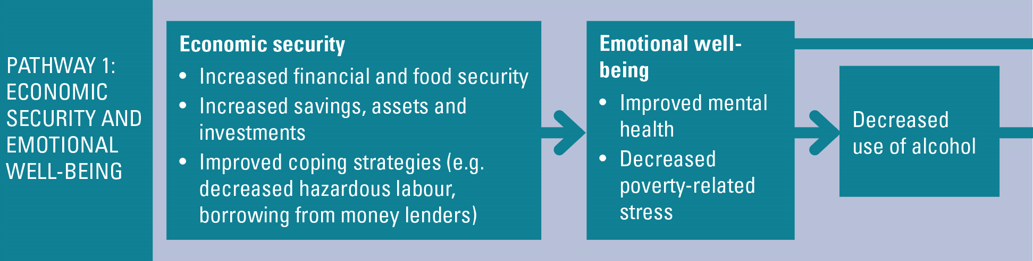
IPV
4 quantitative and 5 qualitative supported this pathway
Linear linkages well supported by large body of rigorous literature
Household level mechanisms, evolving from a pure income effect to emotional wellbeing
Notes:
Talking points:
This pathway operates at household level, regardless of who receives the money
CT and decreased poverty:
Large and robust literature across regions and programme typologies showing that CT’s have significant positive impacts on a range of hh level economic security outcomes
Also, growing literature on documenting positive local economy impacts of CT’s (implying spill-overs
Program design and implementation characteristics such as relative size of transfer, regularity and duration of benefits is important
Economic security and emotional wellbeing
Increasing evidence that poverty and poor mental health are linked in a two-way
Emotional wellbeing and IPV
Evidence suggests that the relationship between poor mental health and IPV victimisation is bidirectional
Situational stress and IPV have also been documented
Economic security, alcohol abuse and IPV
Robust body of evidence from LMIC’s show a strong and consistent association between men’s use of alcohol and women’s risk of IPV

Slide 8
“Well, I think that it [relationship with partner] improved a lot, because as we were saying, the way to a man’s heart is his stomach, so the basic food improves the relationship, and the family gets integrated…”
Male from FGD in Cash, Food & Voucher Transfers plus nutrition training in Northern Ecuador (Buller et al. 2016)
“Apart from the cash, we have been united as a group. The project has brought happiness in the family, as husbands and wives. It has also united parents to their bigger children.”
(Uganda, Nuwakora 2014, p.16)

Slide 9

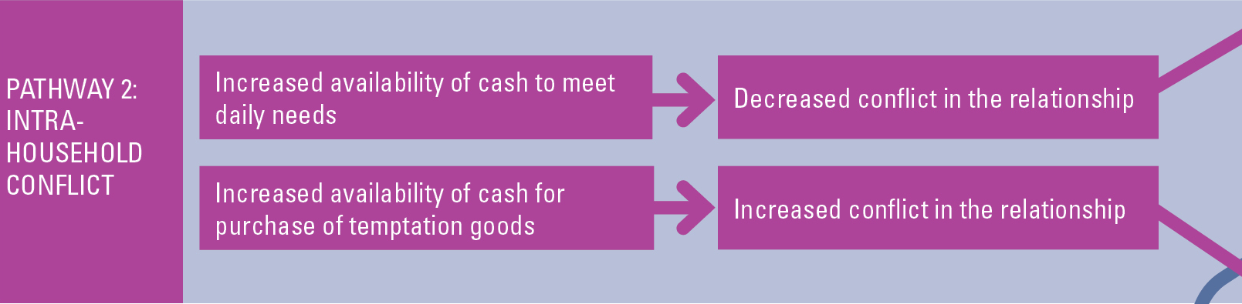
IPV
0 quantitative and 7 qualitative supported pathway
IPV
Linear linkages supported by reviews and select studies
Effect of cash of cash on marital dynamics and conflict
Less evidence on money used for temptation goods, although less evidence available on certain types of temptation goods (i.e. gambling, prostitution)
Notes:
Talking points
This pathway seems to be particularly relevant in poorest households
If money used for temptation goods then more conflict and IPV could result, however there is very little evidence for the use of CT to buy temptation goods
More cash can reduce marital conflict over money or it can increase conflict if the money is diverted to temptation goods or partners disagree on how the money is spent.
CT helped to pay for a number of items such as school fees, medical bills or immediate needs
LESS evidence for people using the money in temptation goods

Slide 10
“There had been many fights. Because children needed many things that we could not have afforded. I asked my husband and he used to say there is no money. Then I used to get upset and started to yell. We had many fights because of poverty. Not only for us, for all poor, fights come from suffering”
Female from IDI in CCT plus in-kind transfers in Turkey (Yidrim et al. 2014)

Slide 11

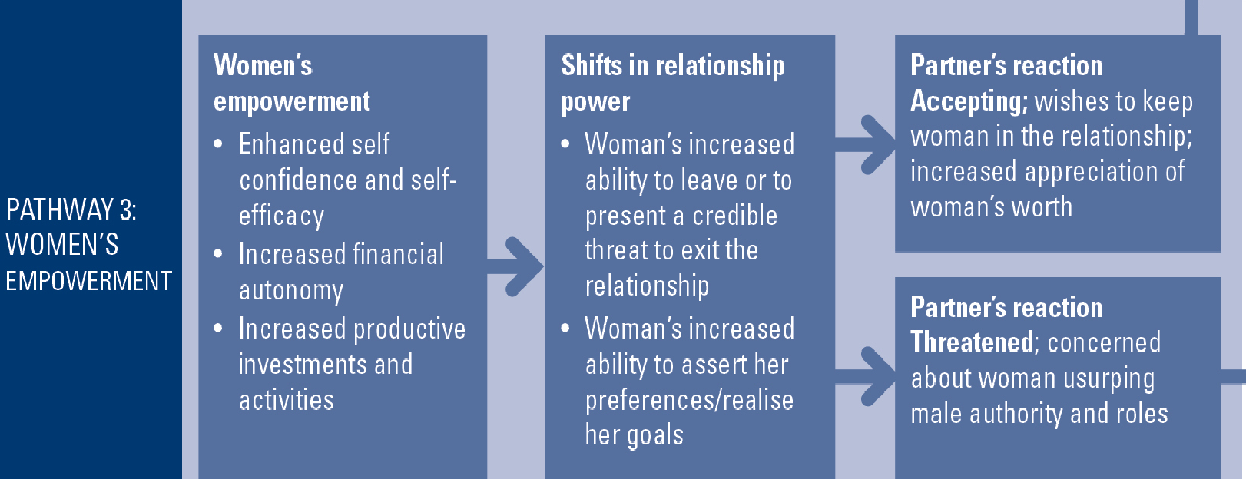
IPV
IPV
11 quantitative and 5 qualitative supported pathway
Large body of literature with mixed/inconclusive findings
Operates at the individual level
Notes:
Talking points
Also mixed results

Slide 12
“Earlier, … my husband would sometimes sell household items without consulting me. But now that I have my own money, I can have a say on how to spend income. ..With the money, a woman may buy seedlings for planting, and hire an ox-plough or tractor or casual labor to dig for her. In case of GBV, the man cannot complain that the woman has made-off with his money or his crops from the garden.”
Female from IDI in UCT in Northern Uganda (Nuwakora 2014)

Slide 13
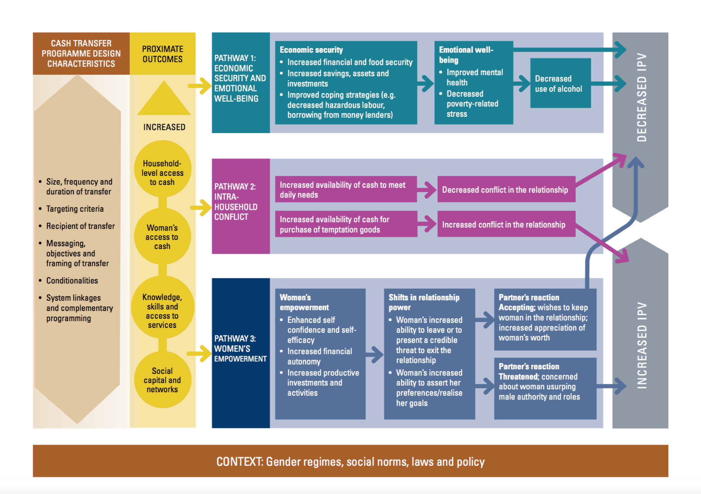
Programme Theory
Buller et al (2018). A mixed-method review of cash transfers and intimate partner violence in low and middle-income countries
Notes:
the far-left box represent different elements of the program design that can influence its impact, such as the size, frequency and duration of transfers, and the targeting criteria, including the particular vulnerability and poverty profiles of the beneficiary population and whether or not women are explicit recipients of the transfer

Slide 14
Program design features
Intra-HH relationships are key: design features to allow women to retain control (messaging, frequency, size of transfer)
Woman as transfer recipient appears important, but few studies test this theory
Plus components potential for synergies (and driver) of reductions in IPV, however cost of implementation must be considered—no evidence on these trade offs
How the transfer is framed, may be quite important in how men respond and therefore may affect impact (e.g. children’s nutrition versus explicit empowerment framing

Slide 15
Conclusions & research gaps
Strong evidence suggest CTs are proven ‘structural’ prevention complements to dedicated vertical programming
Geographic and program design gaps (ability to attribute transfer recipient and plus components)
Better measurement and analysis of mechanisms
Need for more mixed-methods evaluations, and measurement of dynamics over the long(er)-term
Cost-effectiveness measures needed to compare relative to other (vertical/dedicated) programming

Slide 16
Acknowledgements
This work was supported by an anonymous donor. Salary support for Peterman was provided by the UK Department for International Development (DIFD).
We thank Giulia Ferrari, Johannes Haushofer, Deborah Hines, Mazeda Hossain, Elizaveta Perova, Audrey Pettifor, Jeremy Shapiro, Jo Spangaro, Sedona Sweeney, Seema Vyas and Geoff Wong for helpful discussions at project inception.
We thank Jane Sheppard for graphic design assistance, Michael Naranjo for grant administrative support and Lottie Howard-Merrill for support in designing this presentation.

Slide 17
Works cited & additional information
Buller AM, Hidrobo M, Peterman A & Heise L. 2016. The way to a man’s heart is through his stomach?: a mixed methods study on casual mechanisms through which cash and in-kind food transfers decreased intimate partner violence. BMC Public Health 16: 488.
Nuwakora CB. 2014. Combating gender-based violence and enhancing economic empowerment of women in Northern Uganda through cash transfers. External Evaluation. ACF International.
Yildirim, J., Ozdemir, S., & Sezgin, F. 2014. A Qualitative Evaluation of a Conditional Cash Transfer Program in Turkey: The Beneficiaries’ and Key Informants’ Perspectives. Journal of Social Service Research, 40(1), 62-79.
Suggested Citation: AM Buller, A Peterman, M Ranganathan, A Bleile, M Hidrobo & L Heise (2017). A Mixed Methods Review of Cash Transfers & Intimate Partner Violence in LMICs (working paper).

Slide 18
THANK YOU!
More information:
Ana.Buller@lshtm.ac.uk
Meghna.ranganathan@lshtm.ac.uk

Slide 19
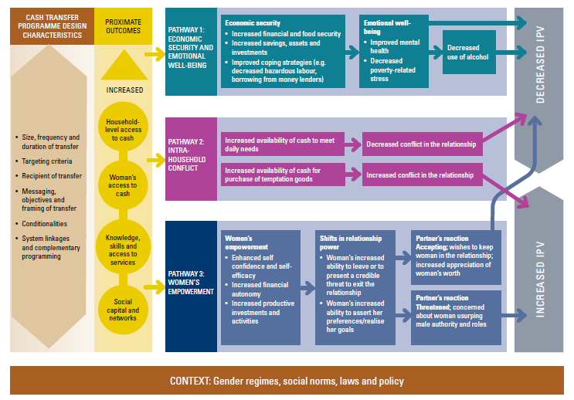

Slide 20
4 quant & 5 qual supported pathway
Linear linkages well supported by large body of rigorous literature
HH level mechanism, evolving from a pure income effect to emotional wellbeing
0 quant & 4 qual supported pathway
Linear linkages supported by reviews & select studies
Evidence of no increases in temptation goods (particularly alcohol use)
11 quant & 4 qual supported pathway
Large body of literature with mixed/inconclusive findings
Operates at individual level

Slide 21
Common gaps: Quant & Qual
Regional: SSA, MENA, Asia (both SA and EAP)—obvious contextual factors important—but we don’t know how
Mixed method work: Only 1 study qualifying (Ecuador cash, food & vouchers), difficult to triangulate findings—leaves unanswered questions
Inter-disciplinary work: Study teams for quant tend to be dominated by Economists (all published papers in Econ journals) with 1-2 exceptions–qual more diverse (development studies or public health)
Time horizons: Most evaluations are ‘snap shots’ so we have little understanding of how impact ‘accumulate’ over time horizons

Slide 22
Gaps: Quantitative
Measurement of IPV improving, still focus on “experience of IPV” and not severity-frequency (intensive margin)
Lots of speculations around mechanisms, particularly women’s empowerment: Almost no actual testing beyond ‘first step’ & no evidence for pathway 2 (intra-household conflict)
Cash-plus and bundled programs not able to break out contribution of different features (only 1 case = Bangladesh)
Does the recipient matter? Only 1 case (Kenya) has randomization to men vs. women

Slide 23
Gaps: Quantitative (cont)
Majority of evaluations test some type of heterogenous effect, but not done consistently – in some cases there are adverse effects, how do we interpret these within larger body of findings?
Magnitude of impacts & CE: Impacts are large (among 13 coefficients, decreases range from 11- 66% and 9 are over 30%), but no understanding of comparison to other interventions (cost-effectiveness)
Administrative data: Three cases (Colombia, Brazil, Uruguay) use quasi-exp methods + administrative data (e.g. domestic assault reports, female homicides)—are there opportunities for leveraging (matching) existing large scale data in other regions?

Slide 24
Gaps: Qualitative
Lack of studies with an explicit objective to test pathways between transfers and IPV (exception: Buller et al. 2016).
  In most studies, the effect on IPV was a finding by chance.
Lack of clarity around definition of IPV; most studies included broader outcomes (e.g. GBV).
Publication bias: Only 2 of the 8 studies were in peer-reviewed outlets (the rest were technical reports undertaken by NGOs).
  This might either be due to a lack of an incentive to publish in journals or a dearth of well designed qualitative studies exploring pathways between CTs and IPV.

Slide 25
Gaps: Qualitative (cont)
Other than one study, majority of qualitative data was collected at one point in time (usually at the end of the programme). In order to explore pathways and measure process of change over time, the qualitative component should be longitudinal.
Need to better understand how cash influences different types of IPV, in particular emotional or economic violence that might be better explored further using qualitative methods.

Slide 26
Program design features
Intra-HH relationships are key: design features to allow women to retain control (messaging, frequency, size of transfer—but in theory is more better?)
Woman as transfer recipient appears important, but few tests of this theory
Plus components potential for synergies (and driver) of reductions in IPV, however cost of implementation must be considered—no evidence on these trade offs

Slide 27
Broader questions
Do these promising impacts “translate” to general populations of women (e.g. beyond rural poor—can we measure distributional impacts)?
Do impacts translate to contributory programming (e.g. labor force, entrepreneurship programs)?
Are there ‘knock on’ effects for other types of intra-familial violence (e.g. violence against children, co-wives etc.)?
Sustainability of impacts?

