Slide 1
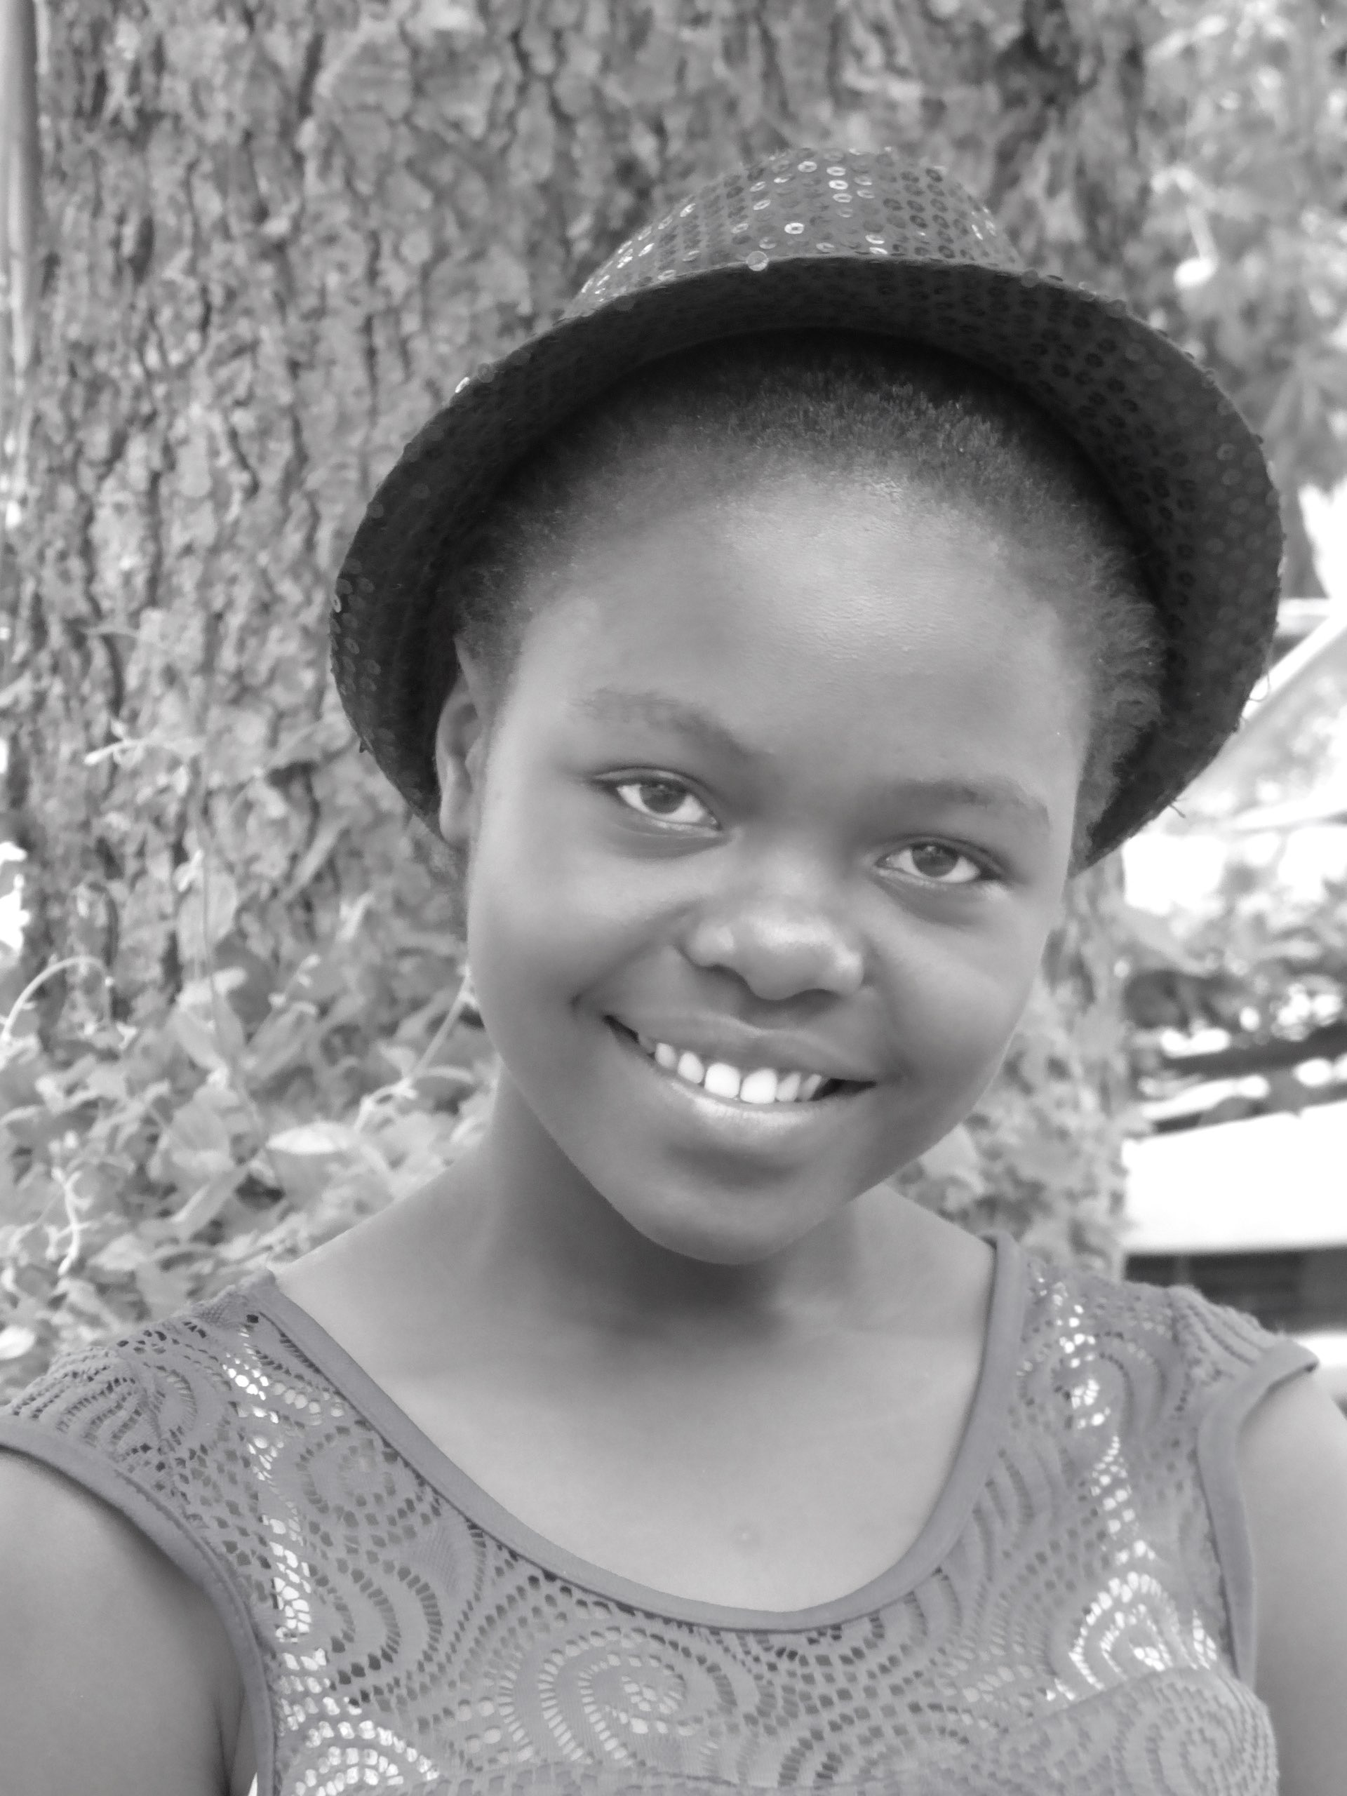
HPTN 068: Impacts on HIV and IPV among young South African women
Audrey Pettifor PhD
University of North Carolina at Chapel Hill

Slide 2
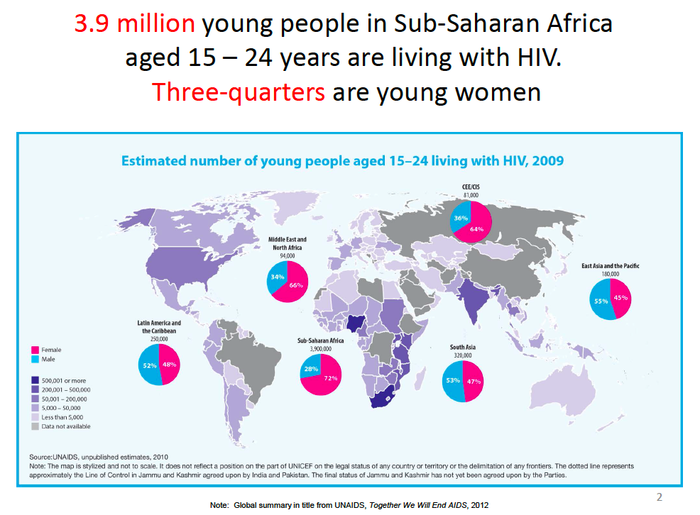
Notes:
Young people are severely affected by HIV Close to 12 million young people aged 15-24 are living with HIV/AIDS
Half of all new infections – over 7000 daily – are occurring among young people
Two-thirds of all new infections are among young women
76% of all new infections among young people occur in women
No other region in the world approaches its HIV prevalence rates or displays such a disproportionate
impact on women and girls: 77 per cent of all HIV-positive women live in sub-Saharan Africa.

Slide 3
Social determinants that increase risk
Education/Schooling
Poverty
Gender Inequity/Violence
Mental Health
Alcohol/Drugs
Notes:
Given there are many determinants that affect HIV risk, given the short time today I am going to focus on those factors that have emerged from our work and that of others as being important and perhaps overlooked to date among young women in South Africa. At the partner level, young women with older partners are more likely to be infected with HIV. What is important to emphasize is that large age disparities are not necessary to put a young woman at risk but, depending on the age of the woman, having a partner only a few year older may increase her risk. Essentially mixing with an age group with the highest prevalence infection places young women at increased risk.
There is also the question of the role of transactional sex in increasing HIV risk. While quantitatively we have not observed a large proportion of young women reporting transactional sex in our research in South Africa, qualitative research abounds with reports of the extensive nature of transactional sex in SSA. Given that I would argue all relationships are transactional in nature to some degree or another, the challenge in measuring transactional sex quantitatively rests in being able to gauge at what point everyday give and take in relationships crosses over to a point where it places an individual at increased risk. I will return to the role of transactional sex later when we discuss interventions, as the recent World Bank study of Cash Transfers suggests the mechanism of action for that study may rest heavily in changing partnership characteristics and averting transactional sex.
At the community/contextual level, Young women reporting less decision making power in relationships are more likely acquire HIV, to report inconsistent condom use and forced sex. Thus interventions that address changing negative gender norms are imperative.
At the structural level, our work in South Africa among young women with one lifetime sex partner consistently finds that the strongest factor associated with HIV infection is education.

Slide 4

HPTN 068: Effects of cash transfer and community mobilization for prevention of HIV in young South African women
Swa Koteka (Yes, we can!)
Randomized Controlled Trial
Intervention: Cash transfer conditional on school attendance to young woman and parent/guardian
Population:~ 2,500 South African young women in grades 8-11, ages 13-20 yrs.(Agincourt, South Africa)
Primary endpoint: HIV incidence in young women
Secondary endpoints: HSV-2, pregnancy, school
attendance, number of sex partners, IPV, number of
unprotected sex acts, age difference with sex
partner and age of coital debut.
Monthly payment conditioned on 80% school
attendance: R100 girl/ R200 guardian
Notes:
HPTN 068: Effects of cash transfer and community mobilization for prevention of HIV in young South African women

Slide 5
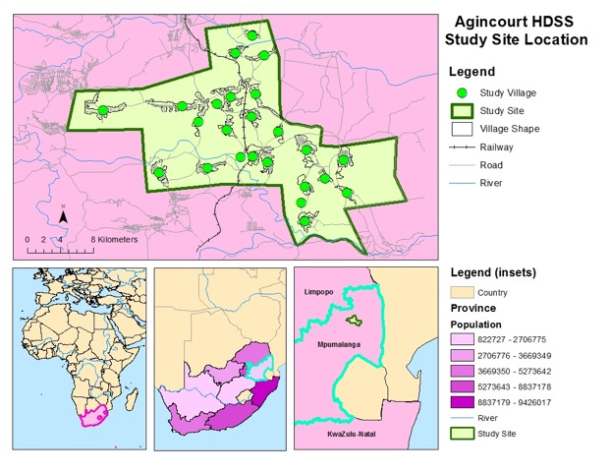

Study Site: Agincourt Health and
Socio-Demographic Surveillance Site (AHDSS)
Ehlanzeni District, Mpumalanga Province
28 villages, 115,000 people, 420 km²
HIV Prevalence 46% and 45% among women and men 35-39 years.
Kahn K, et al. IJE 2012.; Gomez-Olive X, et al AIDS Care 2013.
Notes:
The study took place in the MRC/Wits Agincourt Health and Socio-Demographic Surveillance Site which is located in a rural area in the northeastern part of South Africa in Mpumalanga Province.
The study site is comprised of approximately 115,000 people living in 28 villages
The area characterized by high HIV prevalence at 46% among women and men aged 35-39, high unemployment and migration for work.

Slide 6
Results: Baseline
2,533 young women were enrolled March 2011- December 2012.
2,448 were HIV uninfected at enrollment (81 HIV+, 4 unknown status).
Baseline
Age (Median, IQR) | 15 (14-17)
Ever sex | 26.6%
HIV | 3.2%
HSV-2 | 4.4%
Ever Pregnant | 8.9%
Orphan | 28.6%
Food insecurity | 34.3%
HH receives CSG | 79.0%
Notes:
We enrolled 2,533 young women between March of 2011 and December of 2012 of whom 2,488 were HIV uninfected resulting in a baseline HIV prevalence of 3.2%
Overall this was a relatively young cohort at baseline with a median age of 15 years and among whom close to 27% reported ever having had sex and close to 9% reported ever having been pregnant.
They were also a vulnerable population with close to 29% reporting being a single or double orphan, over a third reporting food insecurity in the past 12 months, and 79% living in homes receiving the government of South Africa’s Child Support Grant

Slide 7
HPTN 068: a conditional cash transfer to reduce HIV risk
No impact of a cash transfer conditional on school attendance on HIV or HSV-2 incidence in young women
No impact on school attendance but school attendance HIGH (95%) in both arms
Cash did reduce physical violence from partners and reduce partner number and unprotected sex
Cash did not reduce transactional sex or older partners
Schooling was protective against HIV
High social protection coverage in the area plus study effects likely resulted in outcomes observed.
Pettifor A, et al. Lancet Glob Health. 2016 Dec;4(12):e978-e988.

Slide 8
IPV: Definition and Measurement
Partner defined as: “current boyfriend or partner or any other partner in [a young woman’s] past”
Survey used 6 physical violence questions and 2 sexual violence questions from WHO survey:
E.g. of a physical violence question:
“Has a partner ever slapped you or thrown something at you that could hurt you?”
E.g. of a sexual violence question:
“Has anyone ever physically forced you to have sexual
intercourse when you did not want to?”
Constructed variables for Any IPV, Any Physical IPV,
Any Sexual IPV, Both Physical and Sexual IPV

Slide 9
Table 2a. Prevalence of ever experiencing physical IPV among adolescent, South African women participating in HPTN068, Baseline, March 2011-December 2012, (n=2533)
Characteristics | Ever Experienced- Total Study Population
 | Number | Prevalence (95% CI)
Any Physical Violence by a partner | 431 | 17.42 (15.99, 18.98)
Partner slapped you or threw something at you that could hurt | 291 | 11.71 (10.51, 13.05)
Partner ever pushed or shoved | 218 | 8.78 (7.74, 9.97)
Partner ever hit you with his fist or with something else that could hurt you | 78 | 3.14 (2.53, 3.91)
Partner ever kicked you, dragged you, or beat you up | 138 | 5.56 (4.73, 6.54)
Partner ever choked or burned you on purpose | 36 | 1.45 (1.05, 2.01)
Partner ever threatened to use or actually used a gun, knife, or other weapon against you | 37 | 1.49 (1.08, 2.05)

Slide 10
Table 2b. Prevalence of ever experiencing sexual IPV among adolescent, South African women participating in HPTN068, Baseline, March 2011-December 2012, (n=2533)
Characteristics | Ever Experienced- Total Study Population
 | Number | Prevalence (95% CI)
Any Sexual Violence by a partner | 113 | 4.54 (3.79, 5.43)
Ever physically forced to have sex when you did not want | 76 | 3.04 (2.44, 3.80)
Ever had sex that you did not want because you were afraid of what the other person might do | 66 | 2.64 (2.08, 3.35)

Slide 11
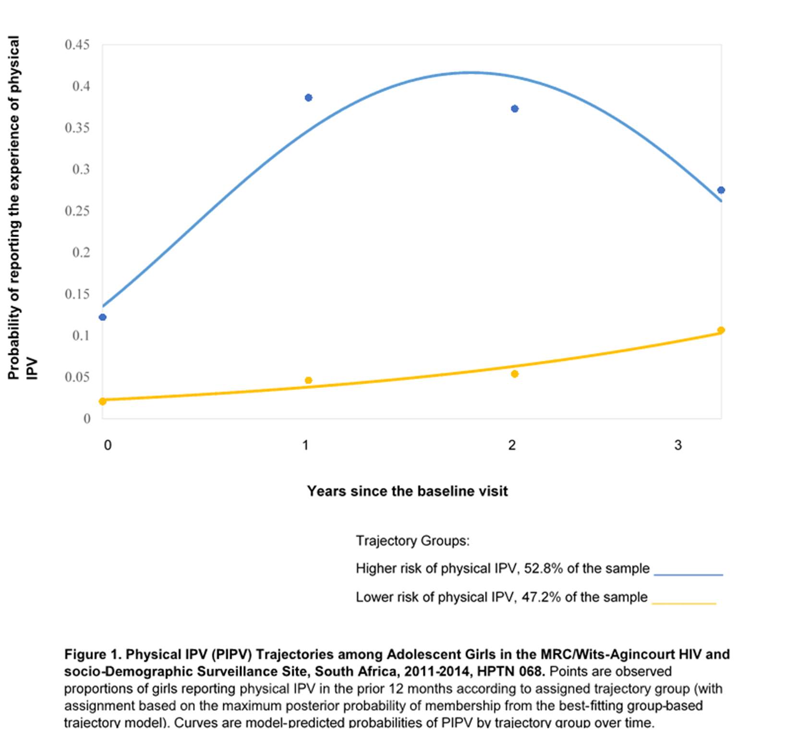
Physical Intimate Partner Violence, HPTN 068
Analytic cohort eligibility (n=907): 8th or 9th grade, enrolled in trial in 2011, 3-4 PIPV data points
Findings
Two groups identified, a higher risk and a lower risk group
Correlates:
  Promoting membership in the higher risk group:
  ever having had vaginal or anal sex, increasing age, borrowing money in the last 12 months
  Protective against higher risk group membership: receipt of the HPTN 068 cash transfer and more equitable gender norms
Poster: Stephanie DeLong et al. IAS 2018 TUPEC244

Slide 12
CCT reduced physical violence
Significant reduction of CCT on physical IPV by 34%
No significant effect on sexual IPV
Pathway analysis finds that this effect is driven partially by not engaging in sex or having fewer sex partners (Kilburn K, et al. J Int AIDS Soc. 2018 Feb;21 Suppl 1.)

Slide 13
CCT- IPV pathways
CCT lead to a reduction in physical IPV
Pathways of protection?
  Cash lead to fewer young women having partners, thus less likely to experience IPV
    Money empowered young women, did not feel the need to take on partners to provide for them?
  CCT not associated with greater relationship power, hope for the future or improved mental health- except among the poorest??
  Money allowed young women to not ‘need’ a partner to provide materials goods (transactional sex or older partner)?
  Cash reduced tension or stress in existing relationships (so no change in partner number but less violence in existing partnership)
  Not associated with differences in school attendance

Slide 14
CTT impact on behavior and mental health: HPTN 068 (Kilburn K, et al. 2018 work in progress)
 |  | SRPS¹ z-scores | CES-D z-scores | Hope z-scores | Any partner | Older¹ partner | Transactional¹ sex
 |  | Coefficient (SE) |  |  | RR (95% CI)
Model 1 | CCT (total effect) | 0.00 | -0.02 | -0.02 | 0.91** | 0.91 | 1.03
 |  | (0.05) | (0.03) | (0.04) | (0.84 - 0.99) | (0.74 - 1.12) | (0.87 - 1.21)
Model 2 | CCT*Baseline poverty | 0.28*** | -0.14** | 0.14** | 1.03 | 0.81 | 0.93
 |  | (0.10) | (0.07) | (0.07) | (0.87 - 1.22) | (0.54 - 1.23) | (0.66 - 1.31)
 | CCT | -0.14* | 0.05 | -0.09* | 0.90* | 1.08 | 1.08
 |  | (0.07) | (0.05) | (0.05) | (0.79 - 1.02) | (0.80 - 1.44) | (0.84 - 1.41)
 | Baseline poverty | -0.22*** | 0.13*** | -0.16*** | 0.99 | 1.05 | 1.23*
 |  | (0.07) | (0.05) | (0.05) | (0.87 - 1.12) | (0.79 - 1.41) | (0.97 - 1.57)
 | Observations | 1,884 | 4,867 | 5,031 | 5,031 | 2,189 | 1,956
Notes:
Strongest effects for poorest girls….

Slide 15
How did they spend the $?
Household expenditures
YW expenditures

Slide 16
AGYW agency in cash
78% percent AGYW indicated that decisions about spending the money were their own
  1% indicated that their boyfriends had a role in decision making about the cash transfer.
80% indicated that they spent the money themselves
No harms related to giving adolescent girls cash
Significant role of cash transfers for adolescent identity, specifically with regard to independence from family and status within the peer networks
MacPhail C, et al. BMC Public Health. 2017 Jul 11;18(1):10

Slide 17
HPTN 068: Cash = empowerment
Cash empowered young women:
“I was scared of him because I was unable to say anything to him but since I was having my own money I have started saying that I don’t like what you are doing.”
“they [partners] knew I don’t want and they cannot force me to do things that I don’t want to do.”
“I can say the money has helped me because I have started to think that I must not date someone who will have a say in my life more than me or who will control me without me saying anything.”
Stoner et al. Work in Progress, 2018.

Slide 18
Discussion
A monthly cash transfer conditional on school attendance did not reduce new HIV infections.
Young women receiving the CCT reported significantly less physical IPV
Fewer partners appears to explain some of the IPV reduction
IPV is high among young, school going population
Cash appears to empower young women to refuse risky partners.
Cash PLUS?
Notes:
Our initial hypothesis was that keeping young women in school through the use of a conditional cash transfer would reduce their risk of HIV infection. Unfortunately we found that there was no difference in HIV acquisition among young women who received the cash transfer and those that did not.
We did find that cash transfers reduced some self-reported risk behaviors. Specifically, young women who received the cash reported significantly fewer partners, less unprotected sex and were less likely to experience intimate partner violence during the trial compared to young women who did not receive the cash.
Surprisingly, there was no difference in school attendance rates by study arm and attendance was very high in both study arms suggesting that the conditional cash transfer was not necessary for girls to attend school in this study area.
Importantly, and as we hypothesized, staying in school was protective for HIV irrespective of study arm. Further analyses will help us understand factors associated with high school attendance and mechanisms through which schooling was protective in this study.
Overall most young women in this trial did not report engaging in HIV risk behaviors, as evidenced by the relatively low HIV incidence observed during the trial. Previous cash transfer programs have found that particular subgroups benefit more from cash transfer than others thus future cash transfer programs may need consider targeting to those at highest risk of HIV. Further analyses of our data will help understand if particular subgroups of young women may have benefited from the cash transfer intervention.

Slide 19

Acknowledgements
Study Investigators
Audrey Pettifor (UNC)
Kathleen Kahn (MRC/Wits Agincourt)
Catherine MacPhail (WrHI/UNE)
Xavier Gomez-Olive (MRC/Wits Agincourt)
UNC
Amanda Selin
Linda Kimaru
Aimee Julien
Cheryl Marcus
Mary Jane Hill
Lisa Albert
Suchindran Chirayath
Harsha Thirumurthy
Sudhanshu Handa
Joseph Eron
Tamu Daniel
Stephanie DeLong
HPTN LOC at FHI360
Phil Andrew
Erica Hamilton
Rhonda White
NIMH
Susannah Allison
Dianne Rausch
NIAID
Sheryl Zwerski
Ellen Townley
Paul Sato
Jenese Tucker
HPTN SDMC
Jim Hughes
Jing Wang
Diana Lynn
Laura McKinstry
Lynda Emel
LSHTM
James Hargreaves
MRC/Wits- Agincourt
Ryan Wagner
Stephen Tollman
Rhian Twine
Wonderful Mabuza
Immitrude Mokoena
Tsundzukani Siwelane
Simon Mjoli
Dumisani Rebombo
Edwin Maroga
Senamile Ndlovu
Audrey Khosa
WrHI
Nomhle Khoza
Sinead Delaney
Helen Rees
HPTN Laboratory Center
Susan Eshleman
Estelle Piwowar-Manning
Oliver Laeyendecker
Yaw Agyei

